Slide 1






The Netherlands eScience Center

Slide 2

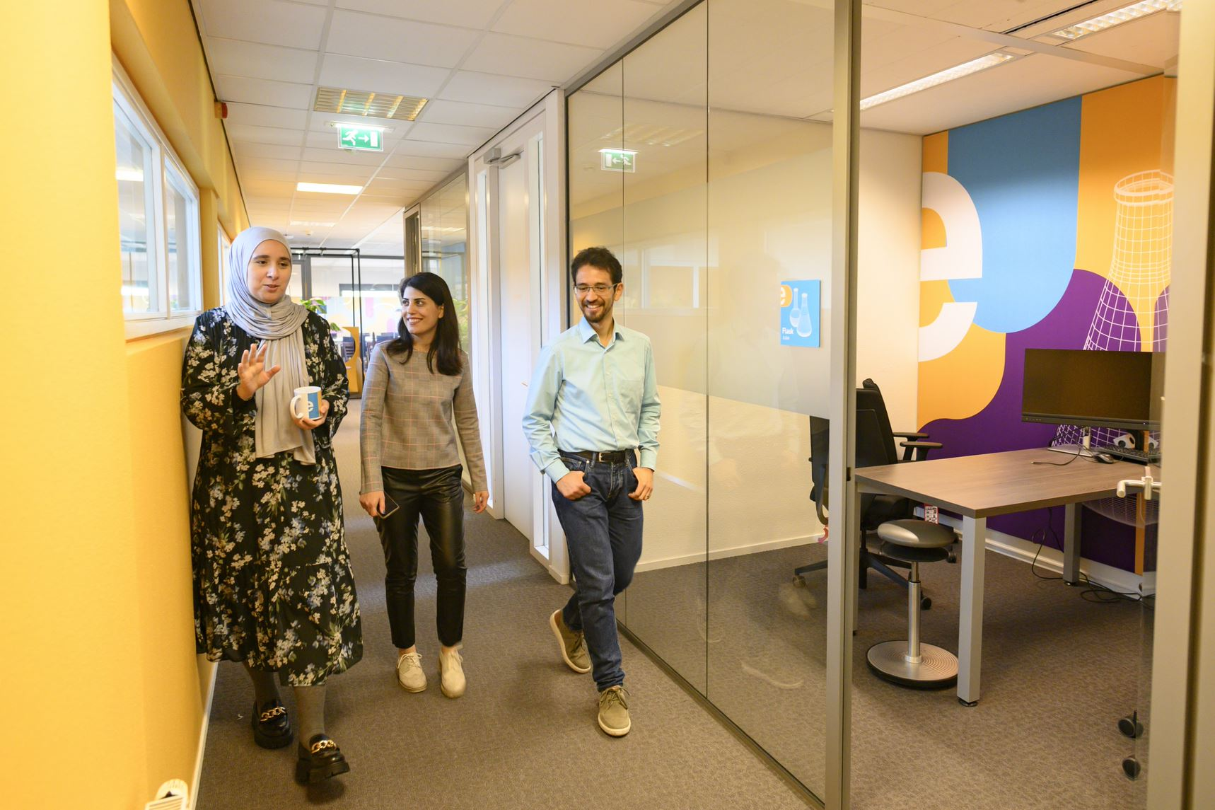

Who are we?
The Netherlands eScience Center is a national center for innovative software solutions in academic research.
Our Research Software Engineers
help researchers interpret results,
make tools and methods reusable for the wider research community,
co-author research and methodological publications,
teach and develop lesson material!

Slide 3
Open-source training materials
Training
Essential
Intermediate
Advanced
Good Practices In Research Software Development
Intermediate Software Development in Python
Open & Reproducible
Research Software
Reproducible Research with R Packages
Introduction to Geospatial Raster and Vector Data with Python
Domain Specific
Foundations of Astronomical Data Science
Image Processing
with Python
Medical image processing
Natural Language Processing
Efficient computing with Julia
Use of technologies
Machine learning
in Python with sci-kit learn
Introduction to Deep Learning
Parallel Programming in Python
GPU Programming
Train the Trainer
Instructor Training
Collaborative Lesson Development

Slide 4
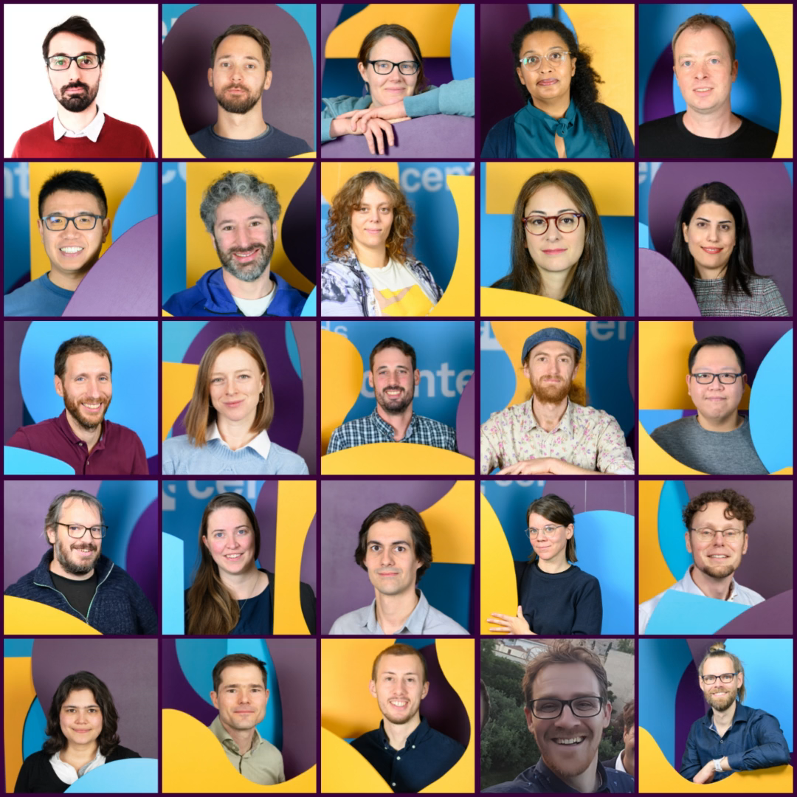
The eScience Center Training Team
Training
For exact dates of upcoming workshops (3 months in advance): esciencecenter.nl/events/?f=workshops
To be notified about coming up workshops, subscribe to the Newsletter: eepurl.com/dtjzwP

Slide 5

Training Programme Schedule 2025 (Q2 is tentative)
 | 2025
January | Introduction to Deep Learning (2 full days in-person)
February | Good Practices in Research Software Development (4 half days online) Efficient computing in Julia – pilot (2 full days in-person)
March | Machine learning in python with scikit-learn (2 full days in-person) Natural Language Processing - pilot (2 full days in-person)
April | Research Software Support Masterclass (spread over 4 weeks, combi in-person and online)
May | Parallel Programming with Python (2 full days in-person) AI-assisted Coding with Codeium? (1 full day in-person)
June | Intermediate Research Software Development with Python (2 full days in-person) Image Processing with Python (2 full days in-person)
For exact dates of upcoming workshops (3 months in advance): esciencecenter.nl/events/?f=workshops
To be notified about coming up workshops, subscribe to the Newsletter: eepurl.com/dtjzwP

Slide 6
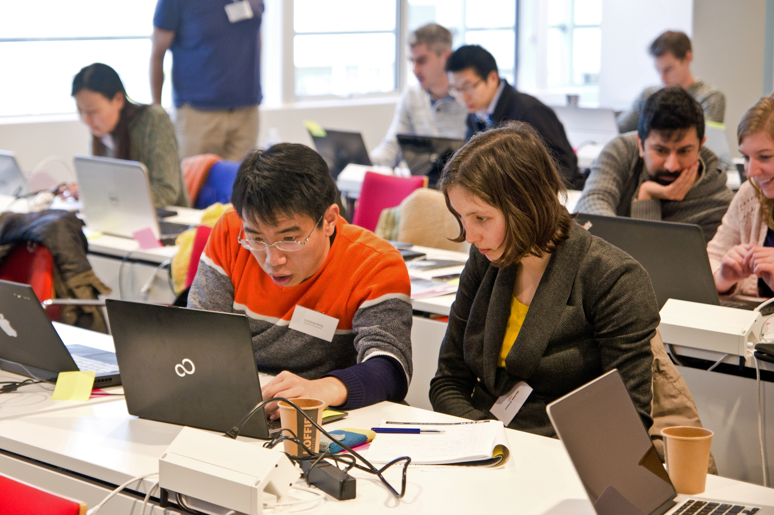


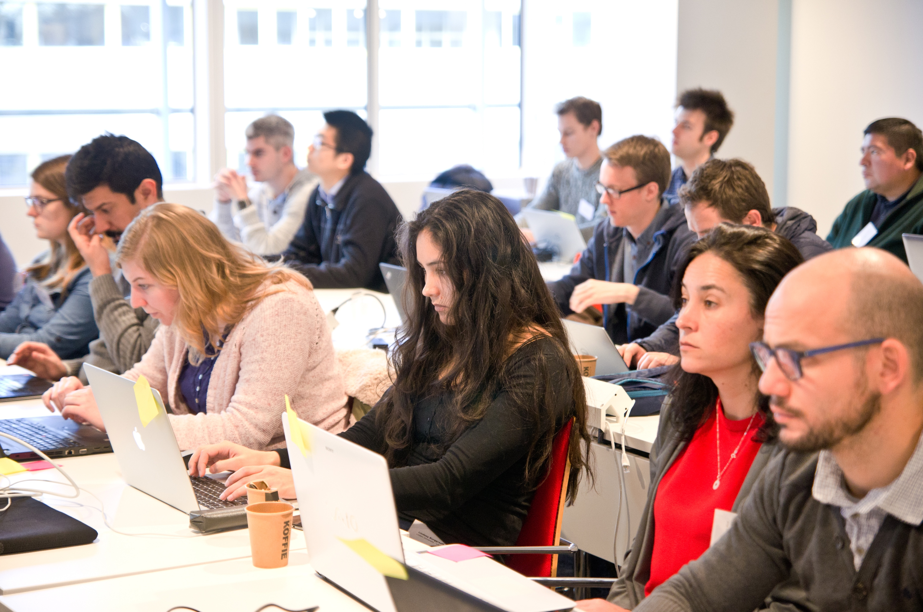

Our Digital Skills Workshops are open to all researchers in the Netherlands. We also offer paid options of standard and custom workshops dedicated to your organisation. To learn more, contact: training@esciencecenter.nl
Do you want us to come and teach a workshop at your organisation?

Slide 7

Do you want to connect with fellow Research Software Engineers?
NL-RSE brings together the community of people writing and contributing to research software from Dutch universities, knowledge institutes, companies and other organizations to share knowledge, to organize meetings, and raise awareness for the scientific recognition of research software.
Website: https://nl-rse.org/
Email: info@nl-rse.org
Twitter: @nl_rse

Slide 8

Do you want to connect to fellow Research software Trainers?
We are a community of training coordinators from Dutch research initiatives delivering training in research software, programming skills, open-source code, and applied data science.
Website: researchsoftwaretraining.nl
Email: rstnl@escience.nl

Slide 9
Submit now!
Become part of the eScience Center community and meet with other Fellows: passionate advocates of research software (3 times a year)
Open to researchers and research software enthusiasts from all disciplines
Receive training, budget and consultancy from eScience Center employees on improving awareness and community efforts around research software
Timeline:
11 April: Deadline project proposal
Early May: Interviews
7 June: kick-off
Fellowship Programme 2023-2024
More info and apply at: esciencecenter.nl/fellowship-programme

Slide 10
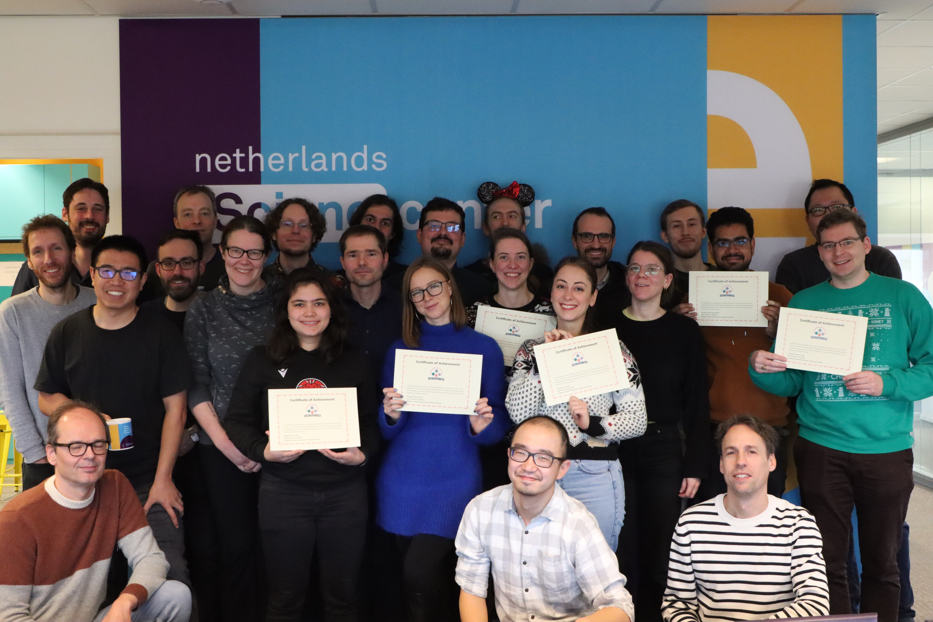
Thank you for attending!
We would love to get your feedback to improve our workshops!
Post-workshop survey

Slide 11
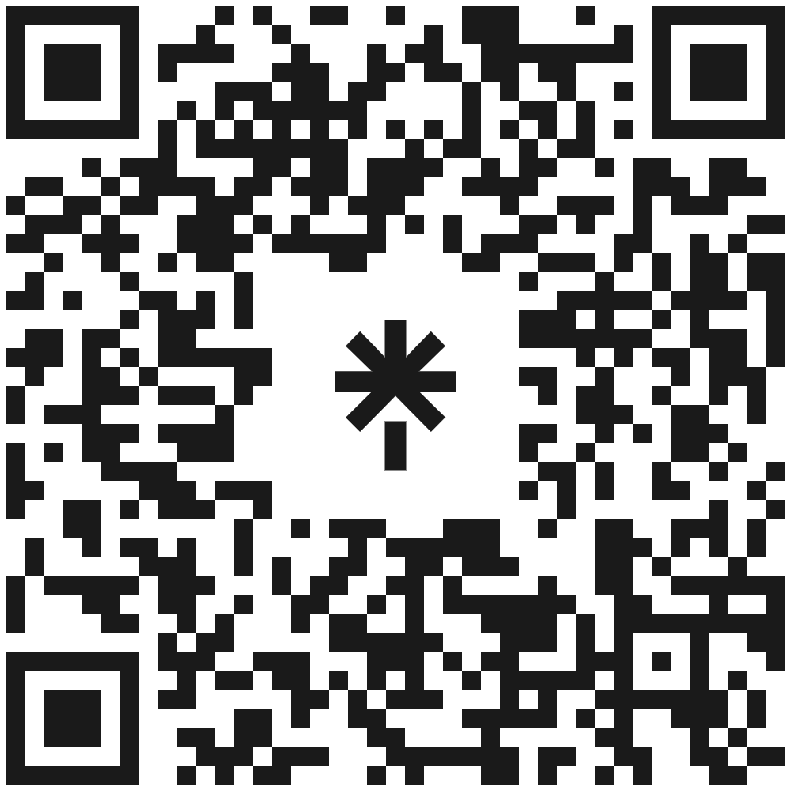







Let’s stay in touch
https://www.esciencecenter.nl/digital-skills/
training@esciencecenter.nl
+31 (0)20 460 4770
@eScienceCenter
Netherlands Escience Center
@eScienceCenter@akademienl.social

